Slide 1
PIC18F4520 Assembly Language Programming (II)
Instruction Set (Logic and Branch)
Yu-Syuan Liu
劉宇軒

Slide 2
Outline
Setup your PIC18F4520 MCU and Pickit3 Debug Board
Lab3-0
Instruction set
Logical Instructions
Lab3-1
Control Operations
Lab3-2
Instruction timing
LAB
Lab Bonus

Slide 3
Outline
Setup your PIC18F4520 MCU and Pickit3 board
Instruction set
Standard Instruction Set
How to see Instruction spec. in Datasheet
Logical Instructions
AND: ANDLW, ANDWF
OR: IORLW, IORWF
XOR: XORLW, XORWF
Bitwise Operations: BSF, BTFSS, BCF, BTFSC (last week BTG)
Rotate Operations: RLCF, RLNCF, RRCF, RRNCF (last semester MSP430 had Shift)
Control Operations
Control Operations: BC, GOTO, NOP (BN, BNC, BNN, BNOV, BNZ, BOV, BZ)
Instruction timing
LAB
Lab3-1: Implement two logic operations: 1. NAND 2. NOR
Lab3-2: Practice Logical Instructions and Control Operations step by step.
Bonus: Explain one instruction of four categories to TAs.

Slide 4
Setup your
PIC18F4520 MCU and Pickit3 Debug Board

Slide 5
Setup your PIC18F4520 MCU and Pickit3 Debug Board
Material list:
PIC18F4520 MCU * 1
Pickit3 Debug Board * 1
麵包板 * 1 (請自備)
PL2303TA (USB轉TTL線) * 1
杜邦雙頭線 (公/公) * 7 (5 + 2)
電阻 (5.6KΩ) * 1
電阻 (300Ω) * 1 (in the future lessons)
LED (藍色/圓頭) * 1 (in the future lessons)

Slide 6
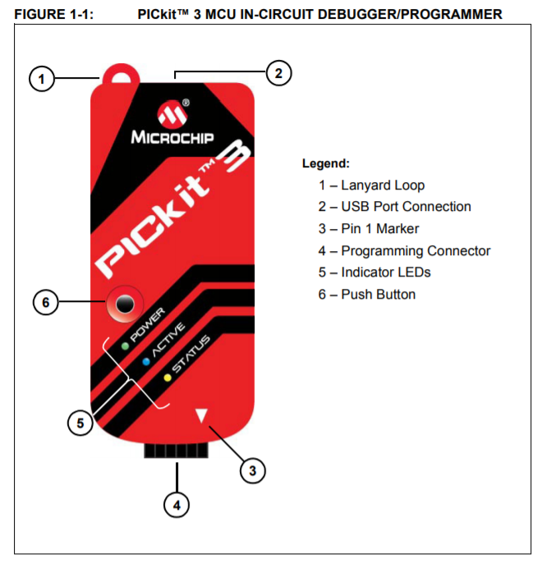
Setup your PIC18F4520 MCU and Pickit3 Debug Board(cont.)
Pickit3
Notes:
5. Status (one of three colors)
Success (green) – ready to start, or successful completion
Busy (orange) – busy with a function in progress, e.g., programming
Error (red) – an error has occurred
6. Push Button
The push button is used for Programmer-To-Go operations.

Slide 7
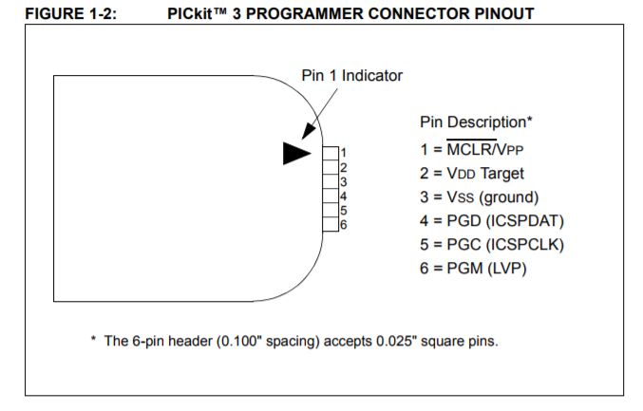
Setup your PIC18F4520 MCU and Pickit3 Debug Board(cont.)
Pickit3 pins
Notes:
1. MCLR
內建電壓比較裝置 當VDD上升的同時(上電時) MCLR同時給>7.5V的電壓 進入燒錄模式
若外接外部燒錄器先燒錄 MCLR直接接VDD或電阻電容之類的Reset專用IC 就可以做Reset動作
4. PGD 傳Data
5. PGC 傳Clock
6. 支持LVP (LVP : Low Voltage Programming) PICKit3 不支援此功能 所以目前第六腳是保留pin 防呆專用

Slide 8
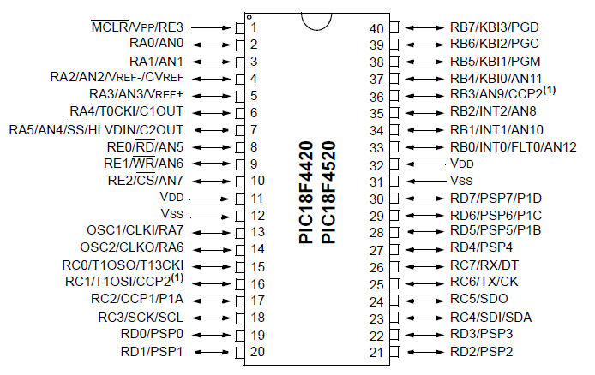
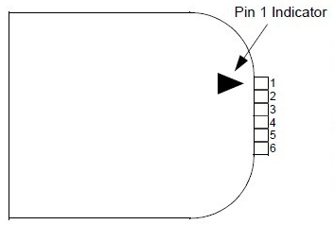
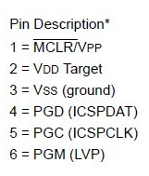
Setup your PIC18F4520 MCU and Pickit3 Debug Board(cont.)
Pickit3
PIC18F4520
Notes:
Lack:
1. pictures
2. board’s pic +- lines introduction
eZ-FET USB to UART 的介面 http://processors.wiki.ti.com/index.php/EZ-FET_lite

Slide 9
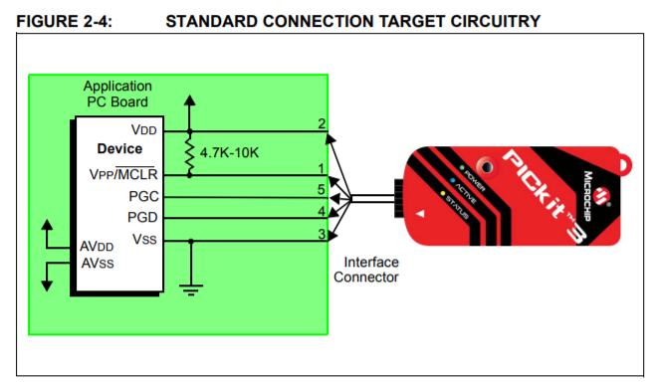
Setup your PIC18F4520 MCU and Pickit3 Debug Board(cont.)
Notes:
5.6K歐姆for上升電壓 穩壓

Slide 10
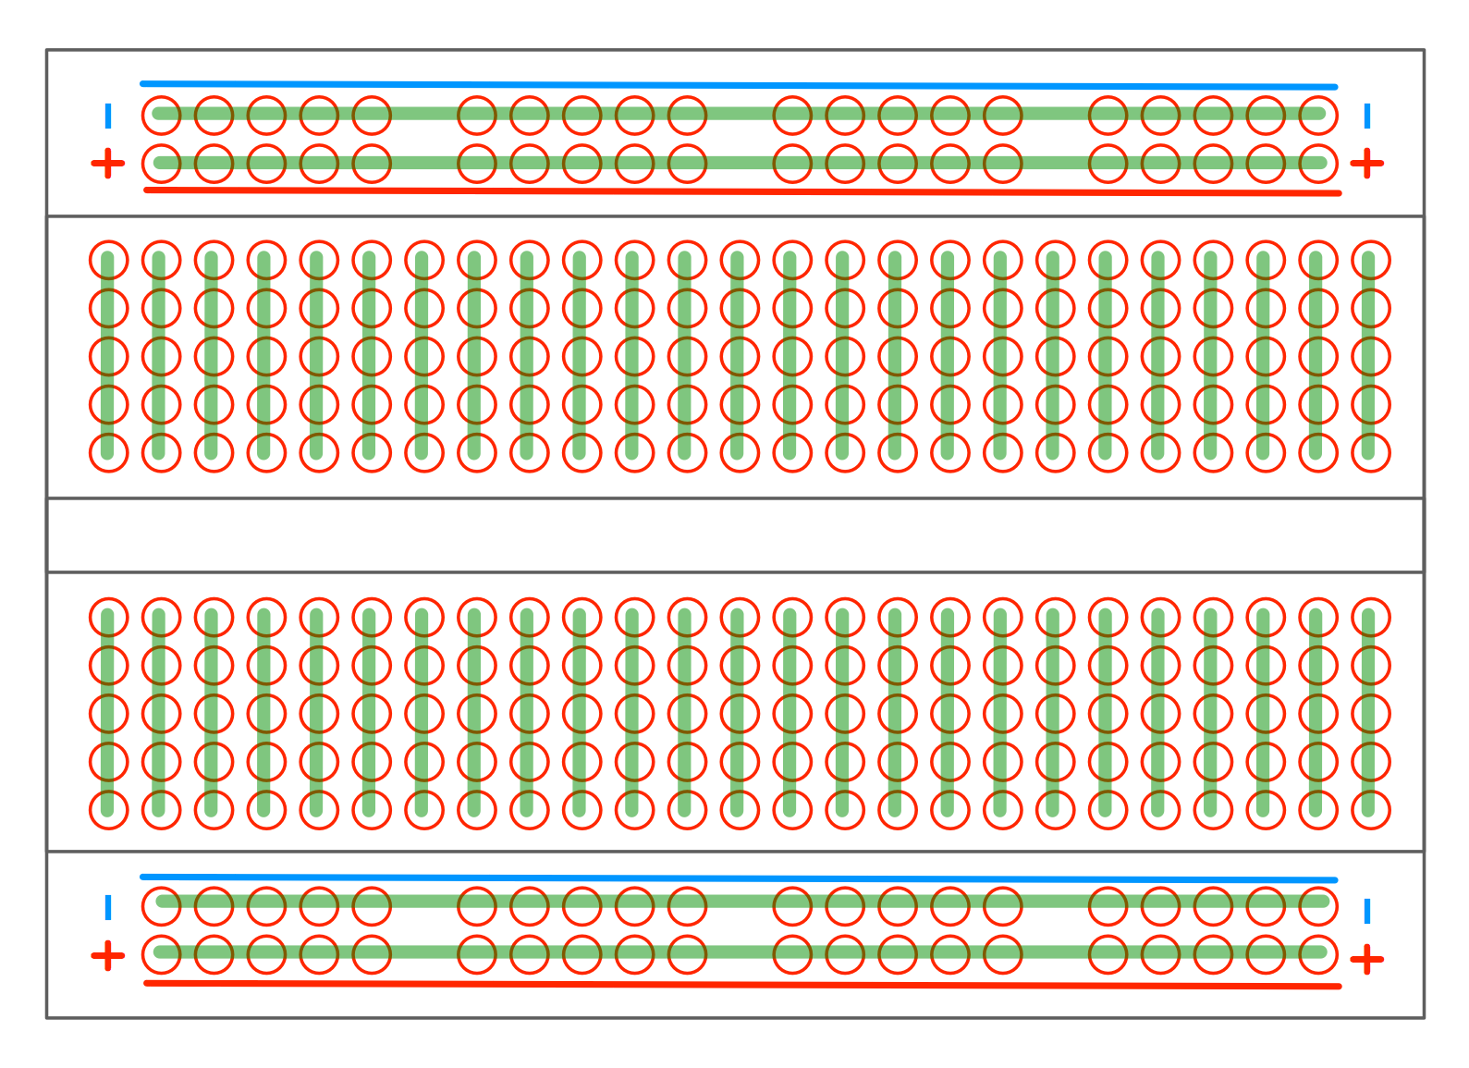
Setup your PIC18F4520 MCU and Pickit3 Debug Board(cont.)
BreadBoard

Slide 11
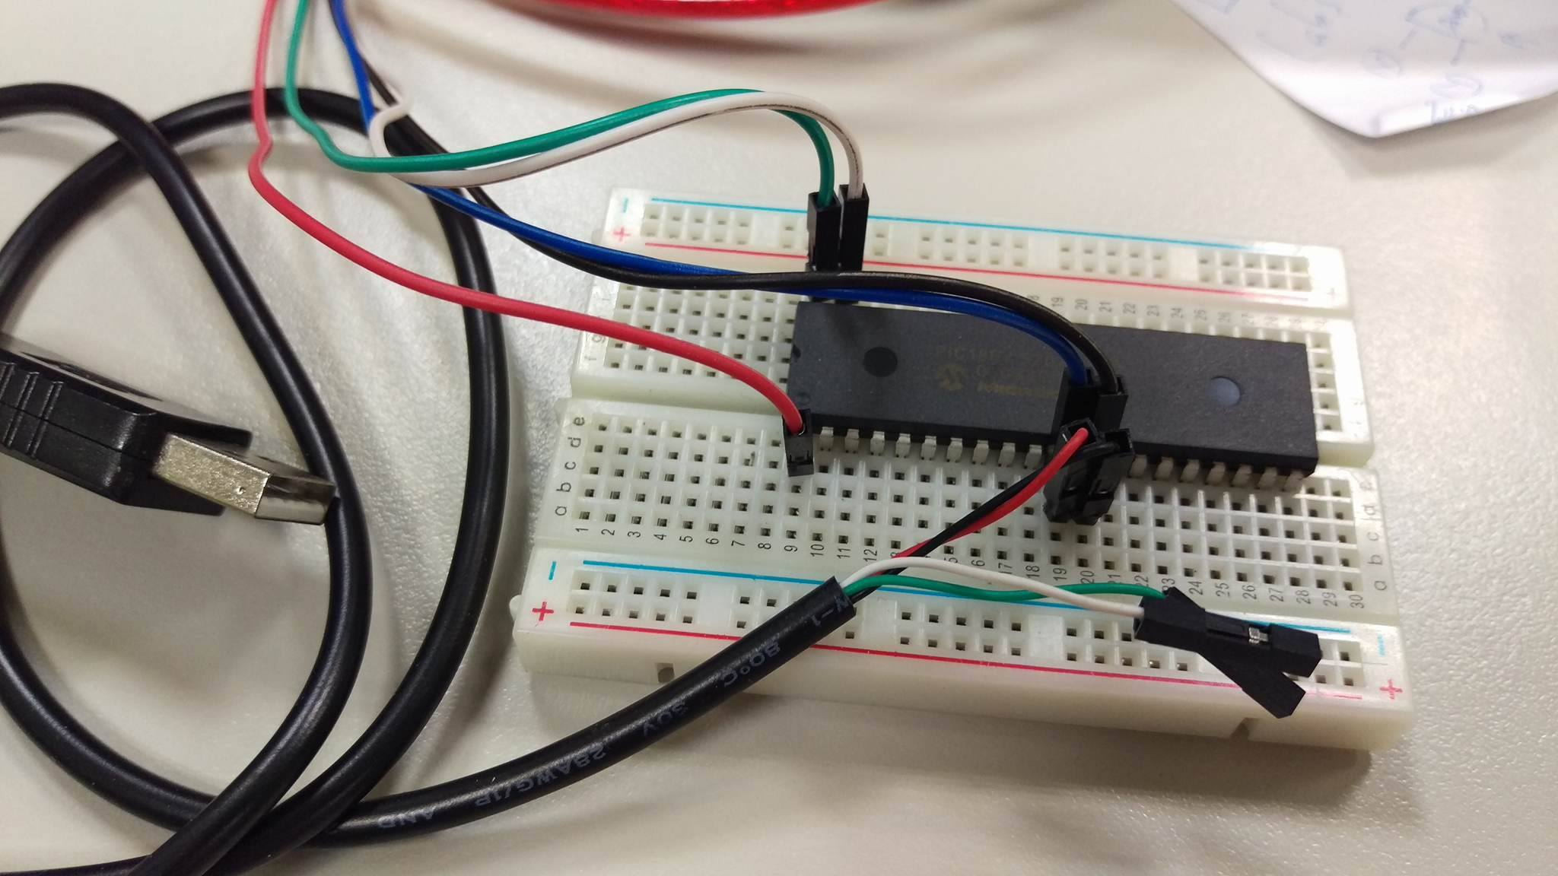
Setup your PIC18F4520 MCU and Pickit3 Debug Board(cont.)
Easy version

Slide 12
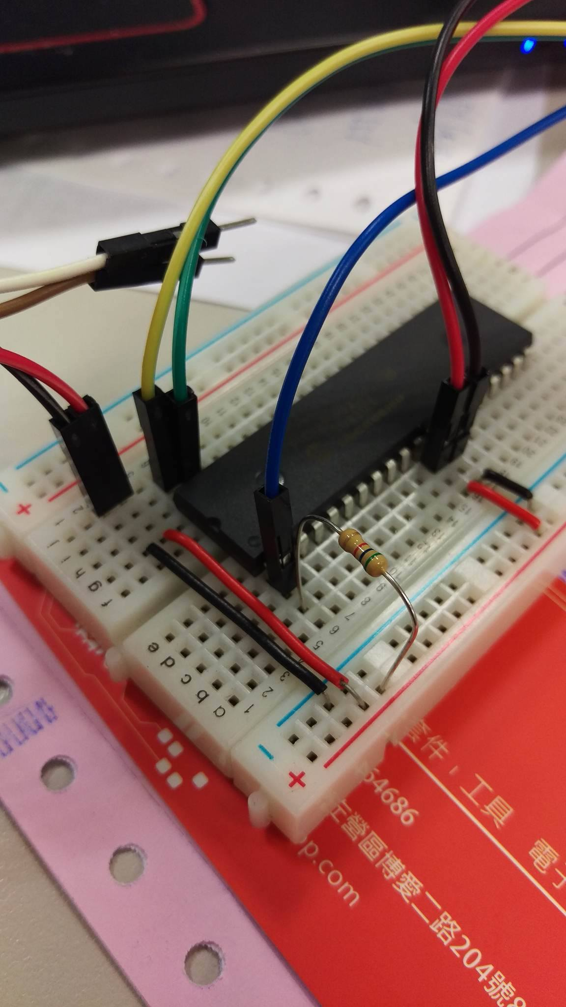
Setup your PIC18F4520 MCU and Pickit3 Debug Board(cont.)

Slide 13
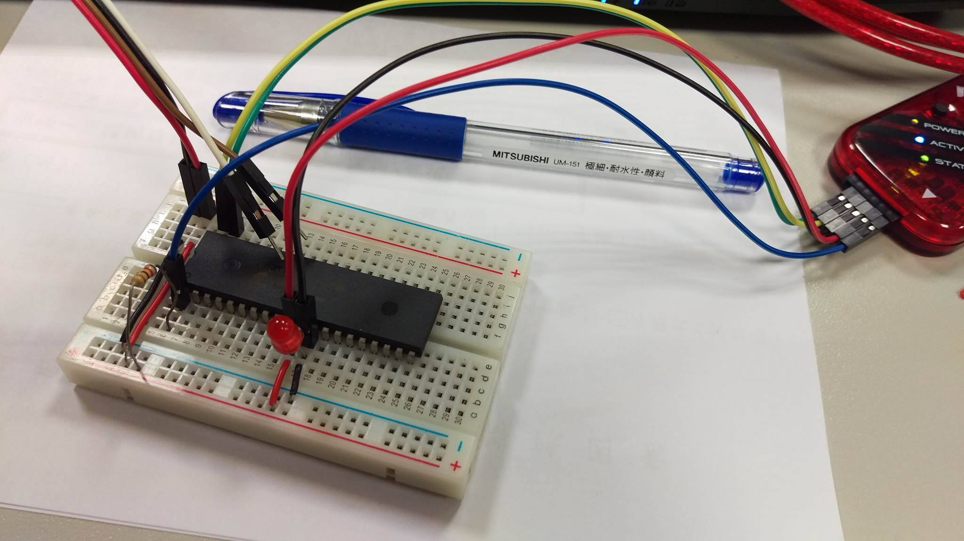
Setup your PIC18F4520 MCU and Pickit3 Debug Board(cont.)

Slide 14
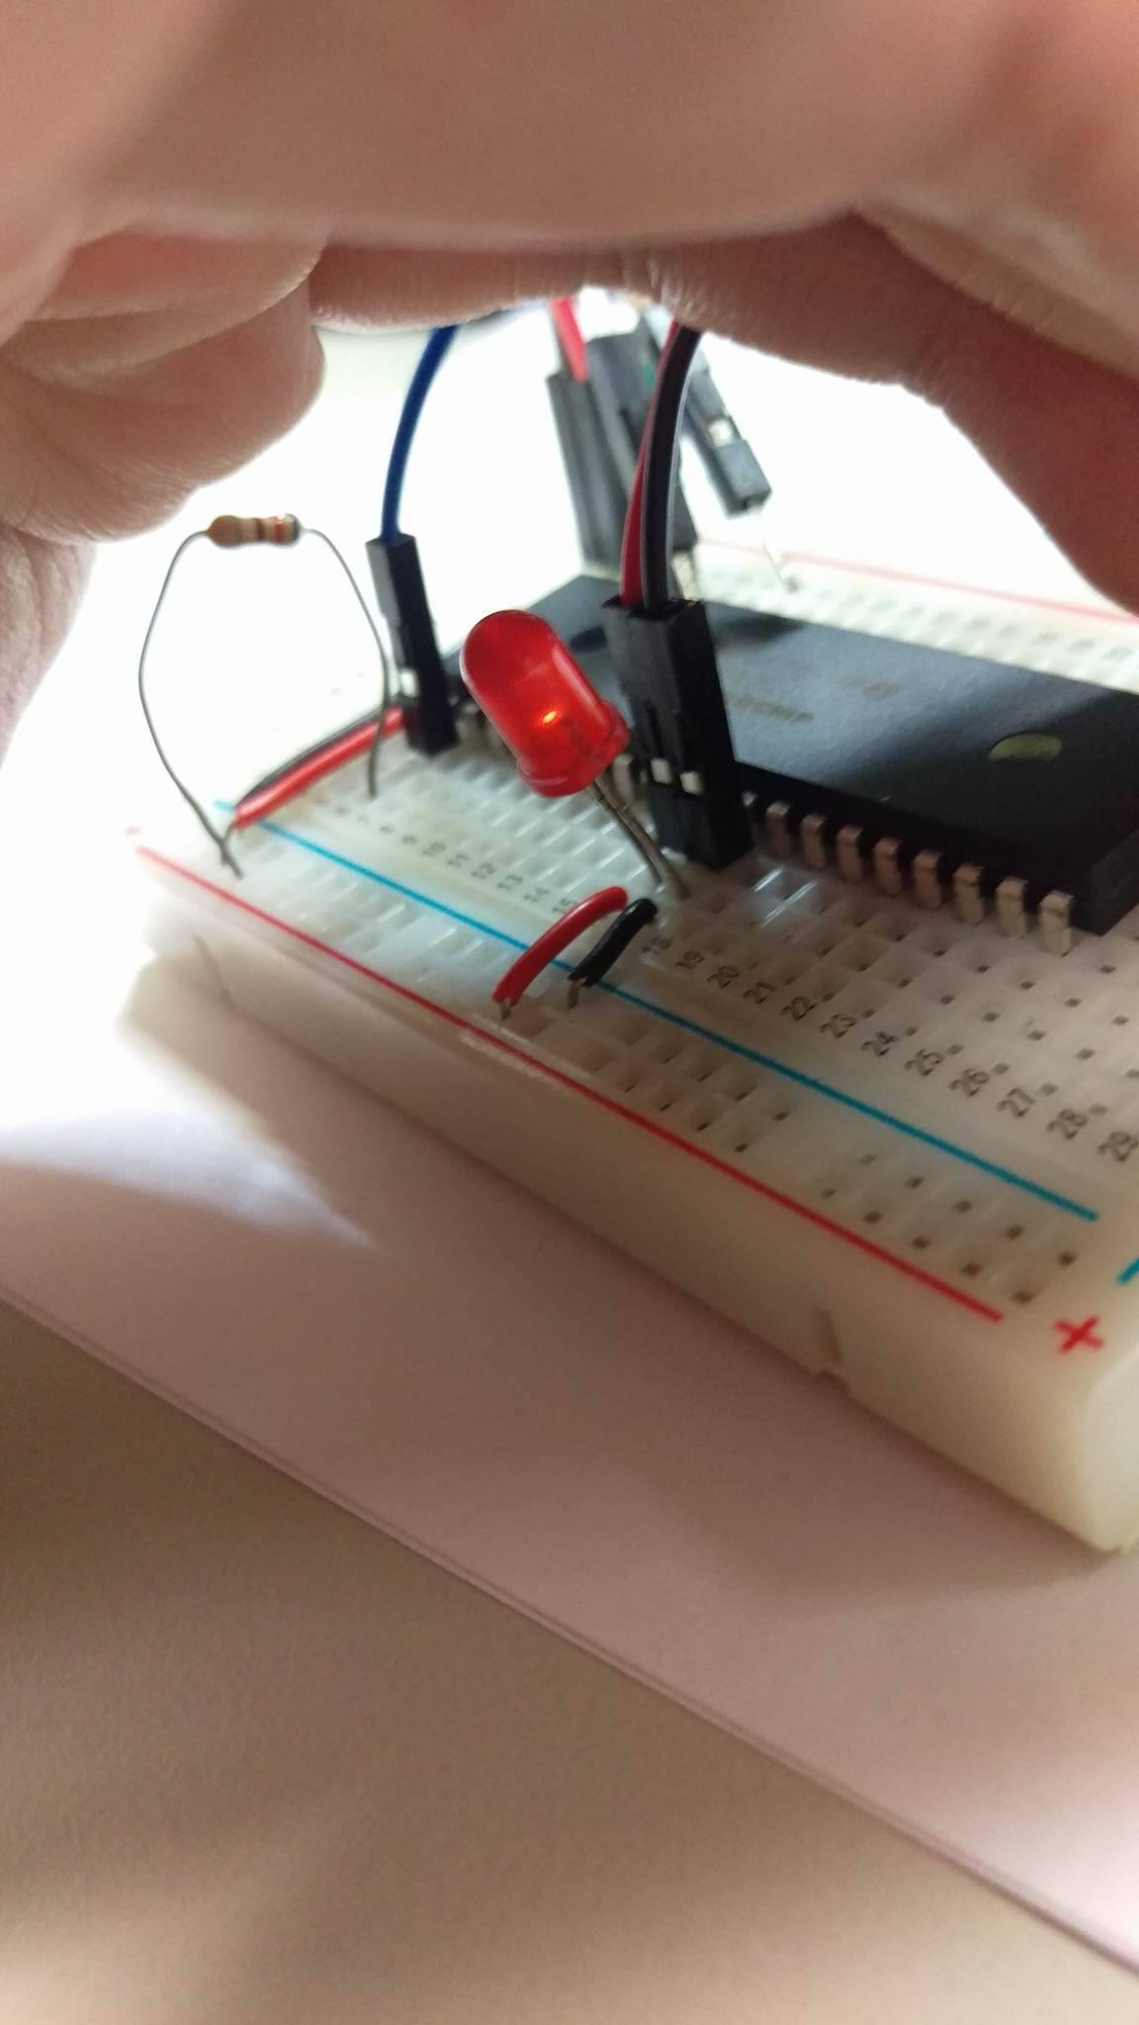
Setup your PIC18F4520 MCU and Pickit3 Debug Board(cont.)

Slide 15
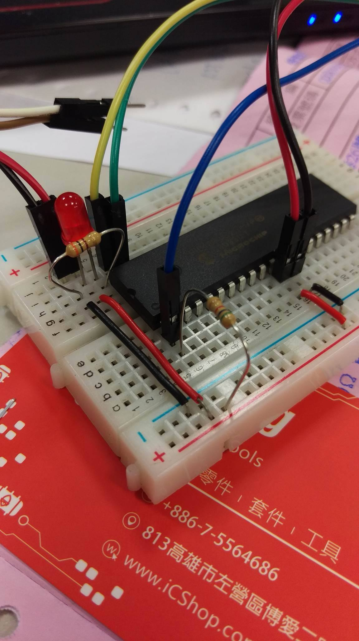
Setup your PIC18F4520 MCU and Pickit3 Debug Board(cont.)

Slide 16
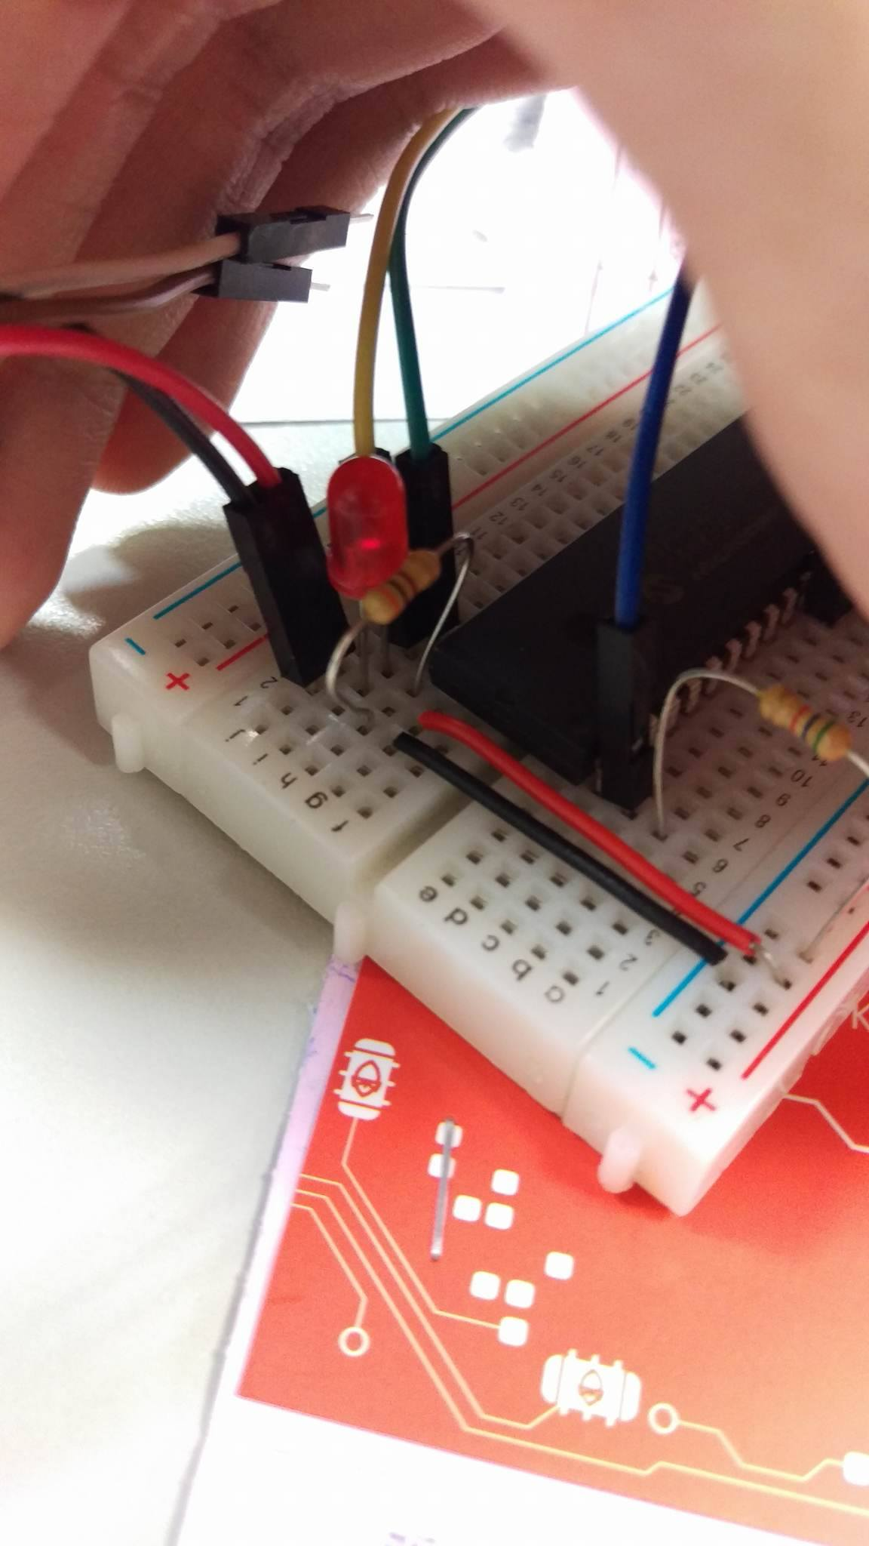
Setup your PIC18F4520 MCU and Pickit3 Debug Board(cont.)

Slide 17
LAB - Lab3-0
Lab3-0
Try to set up your PIC18F4520 MCU and Pickit3 Debug Board, for the development environment in the future.
If everything is well, choose the Pickit3 as Hardware tool in MPLAB X IDE.
If you don’t have the material enough or something error when you set up, choose the Simulator as Hardware tool in MPLAB X IDE, just like the class last week.
Run the code “Lab3_lab3-0” for testing Pickit3.

Slide 18
Instruction set

Slide 19
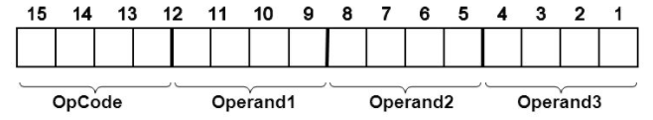
Standard Instruction Set
PIC18F2420/2520/4420/4520 devices incorporate the standard set of 75 PIC18 core instructions.
Each single-word instruction is a 16-bit word divided into an opcode, which specifies the instruction type and one or more operands, which further specify the operation of the instruction.
Notes:
As well as an extended set of 8 new instructions, for the optimization of code that is recursive or that utilizes a software stack.
But the OPCODE is not definitely the 4-bit, see next page.

Slide 20
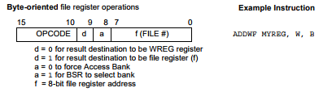
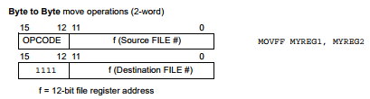
Standard Instruction Set (cont.)
Notes:
1. OPCODE is 6-bit, and it also can be 4-bit.
OPCODE just like your Student ID Card.
2. Most of the instructions are single-word, but there are 4 instructions are 2-word
(So it need 32-bit length. If this second word is executed as an instruction (by itself), it will execute as a NOP. ).
3. The file register always is 8-bit, but it can be 12-bit because add the BSR<3:0> to select Bank by your wish, as the speech last TA said.

Slide 21
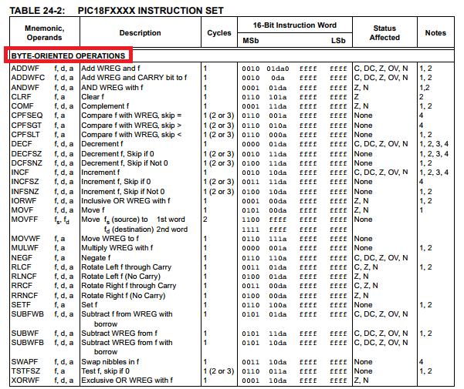
Standard Instruction Set (cont.)
Notes:
Most byte-oriented instructions have three operands:
1. The file register (specified by ‘f’)
2. The destination of the result (specified by ‘d’)
3. The accessed memory (specified by ‘a’)
The file register designator ‘f’ specifies which file register is to be used by the instruction.
The destination designator ‘d’ specifies where the result of the operation is to be placed.
d = 0: store result in WREG
d = 1: store result in file register f
‘a’ is RAM access bit
a = 0: RAM location in Access RAM (BSR register is ignored)
a = 1: RAM bank is specified by BSR register

Slide 22
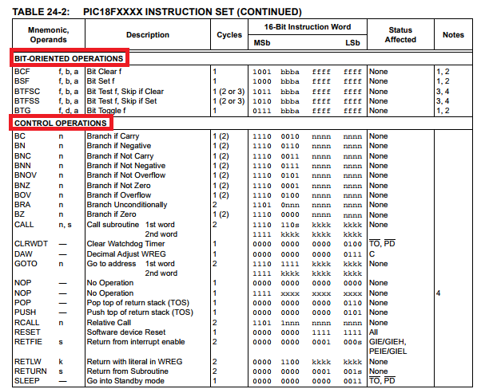
Standard Instruction Set (cont.)
Notes:
All bit-oriented instructions have three operands:
1. The file register (specified by ‘f’)
2. The bit in the file register (specified by ‘b’)
3. The accessed memory (specified by ‘a’)
The bit field designator ‘b’ selects the number of the bit affected by the operation
, while the file register designator ‘f’ represents the number of the file in which the bit is located.
The control instructions may use some of the following operands:
• A program memory address (specified by ‘n’)
• The mode of the CALL or RETURN instructions (specified by ‘s’)
• The mode of the table read and table write instructions (specified by ‘m’)
• No operand required (specified by ‘—’)

Slide 23
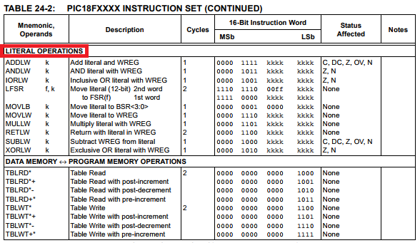
Standard Instruction Set (cont.)
Notes:
The literal instructions may use some of the following operands:
• A literal value to be loaded into a file register (specified by ‘k’)
• The desired FSR register to load the literal value into (specified by ‘f’)
• No operand required (specified by ‘—’)
The TBLRD instruction is used to retrieve data from program memory and places it into data RAM.
主要用在Data Memory 與 Program Memory的位址搬動 就是前面上課講過的(P: 21-bit D: 16 banks) 但我們自己也不常用哈哈

Slide 24
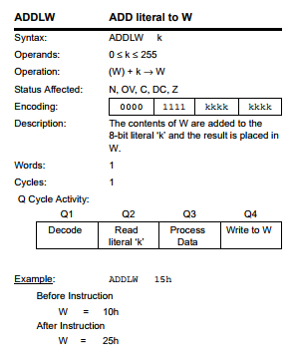
How to see Instruction spec. in Datasheet
Notes:
Remember the exam last week, the five steps of a instruction cycle is like this: IF -> ID -> EX -> MM -> WB (and also in pipeline)

Slide 25
Logical Instructions

Slide 26
Logical Instructions
1. AND
ANDLW - AND literal with W (with One Operand)
Ex.
ANDWF - AND W with f (with Two Operands)
Ex.
; Before: W = A3h = 1010 0011
ANDLW 05Fh ;05Fh = 0000 0101 1111
; After: W = 03h = 0000 0011₍₂₎ = 0x03₍₁₆₎
; Before: W = 17h, REG = C2h
ANDWF REG, 0, 0 ;d=0 in W, a=0 Access Bank
; After: W = 02h, REG = C2h
Notes:
05Fh care about the “0”

Slide 27
Logical Instructions (cont.)
2. OR
IORLW - Inclusive OR literal with W (with One Operand)
Ex.
IORWF - Inclusive OR W with f (with Two Operands)
Ex.
; Before: W = 9Ah = 1001 1010
IORLW 35h
; After: W = BFh = 1011 1111
; Before: RESULT = 13h, W = 91h
IORWF RESULT, 0, 1
; After: RESULT = 13h, W = 93h

Slide 28
Logical Instructions (cont.)
3. XOR
XORLW - Exclusive OR literal with W (with One Operand)
Ex.
XORWF - Exclusive OR W with f (with Two Operands)
Ex.
; Before: W = B5h = 1011 0101
XORLW 0AFh
; After: W = 1Ah = 0001 1010
; Before: REG = AFh, W = B5h
XORWF REG, 1, 0
; After: REG = 1Ah, W = B5h

Slide 29
Logical Instructions (cont.)
4. Bitwise Operations
BSF - Bit Set f (with Two Operands)
Ex.
BTFSS - Bit Test File, Skip if Set (with Two Operands)
Ex.
; Before: FLAG_REG = 0Ah = 0000 1010
BSF FLAG_REG, 7, 1
; After: FLAG_REG = 8Ah = 1000 1010
; Before: PC = address(HERE)
BTFSS FLAG, 1, 0 ;HERE
;FALSE
;TRUE
; After:
; If FLAG<1> = 0, PC = address(FALSE)
; If FLAG<1> = 1, PC = address(TRUE)
Notes:
BTFSS’s Datasheet cycle is important

Slide 30
Logical Instructions (cont.)
4. Bitwise Operations (cont.)
BCF - Bit Clear f (with Two Operands)
Ex.
BTFSC - Bit Test File, Skip if Clear (with Two Operands)
Ex.
; Before: FLAG_REG = C7h = 1100 0111
BCF FLAG_REG, 7, 0
; After: FLAG_REG = 47h = 0100 0111
; Before: PC = address(HERE)
BTFSS FLAG, 1, 0 ;HERE
;FALSE
;TRUE
; After:
; If FLAG<1> = 0, PC = address(TRUE)
; If FLAG<1> = 1, PC = address(FALSE)

Slide 31

Logical Instructions (cont.)
5. Rotation Operations
RLCF - Rotate Left f throught Carry (with Two Operands)
Ex.
Flow Diagram.
; Before: REG = 1110 0110, C = 0
RLCF REG, 0, 0
; After: REG = 1110 0110, W = 1100 1100, C = 1

Slide 32

Logical Instructions (cont.)
5. Rotation Operations (cont.)
RLNCF – Rotate Left f No Carry (with Two Operands)
Ex.
Flow Diagram.
; Before: REG = 1010 1011
RLNCF REG, 1, 0
; After: REG = 0101 0111

Slide 33

Logical Instructions (cont.)
5. Rotation Operations (cont.)
RRCF – Rotate Right f throught Carry (with Two Operands)
Ex.
Flow Diagram.
; Before: REG = 1110 0110, C = 0
RRCF REG, 0, 0
; After: REG = 1110 0110, W = 0111 0011, C = 0

Slide 34

Logical Instructions (cont.)
5. Rotation Operations (cont.)
RRNCF – Rotate Right f No Carry (with Two Operands)
Ex.
Flow Diagram.
; Before: REG = 1101 0111, W = ?
RLNCF REG, 0, 0
; After: REG = 1101 0111, W = 1110 1011

Slide 35
LAB - Lab3-1
Lab3-1
Recall what you had learned in Digital Logic Design (數位邏輯設計) class. (If you have already forgot all thing, Google is always your best friend.)
Implement two logic operations below:
1. NAND: 10110101 NAND 01111100, and store result in LATD
2. NOR: 10010110 NOR 01101001, and store result in LATC
Tips:
Use WREG as your temporary register.
Use AND, OR, XOR instructions to finish ONLY.
(DO NOT give the LATD and LATC values DIRECTLY)

Slide 36
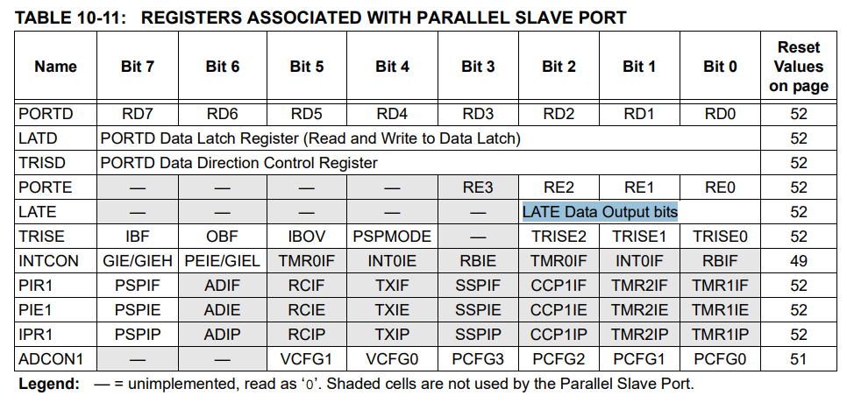
LAB - Lab3-1 - Restriction of LATE and PORTE

Slide 37
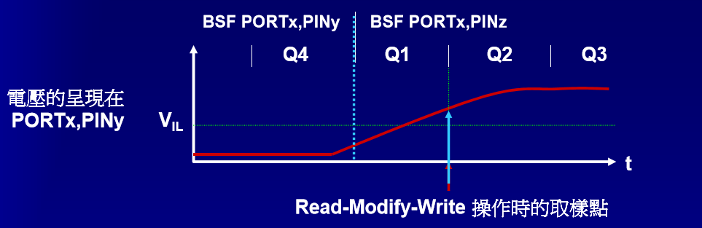
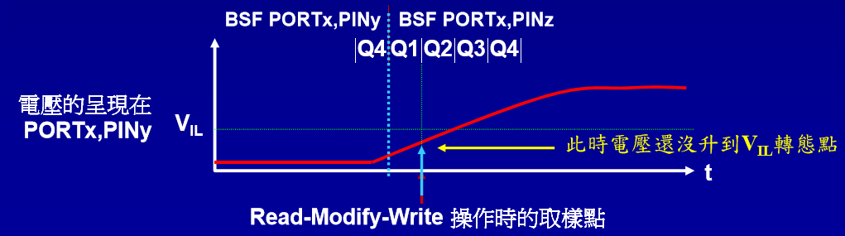
LAB - Lab3-1 - Why use LATx instead of PORTx
1. 如果工作在較低頻率 或 較小的附載電容環境
2. 如果工作在較高頻率 或 較大的附載電容環境
Notes:
如何解決 Read-Modify-Write?
1. 如果對相同的PORTx連續操作 - 加個NOP吧
BSF PORTA, 5
NOP
BSF PORTA, 0
2. 建議直接使用LATx來取代PORTx的操作
BSF LATA, 5
BSF LATA, 0

Slide 38
Control Operations

Slide 39

Control Operations
1. BC (Branch if Carry)
Ex.
; Before: PC = address(HERE)
BC 5 ;HERE
; After:
; If CARRY = 1, PC = address(HERE + 12)
; If CARRY = 0, PC = address(HERE + 2)

Slide 40
Control Operations (cont.)
2.
BN (Branch if Negative)
BNC (Branch if Not Carry)
BNN (Branch if Not Negative)
BNOV (Branch if Not Overflow)
BNZ (Branch if Not Zero)
BOV (Branch if Overflow)
BZ (Branch if Zero)

Slide 41
Control Operations (cont.)
3. GOTO (Unconditional Branch)
Description: GOTO allows an unconditional branch anywhere within entire 2-Mbyte memory range. The 20-bit value ‘k’ is loaded into PC<20:1>.
GOTO is always a two-cycle instruction.
4. NOP (No Operation)
Description: No operation.

Slide 42
LAB - Lab3-2
Lab3-2
Practice following Logical Instructions and Control Operations step by step.
1. Add from 1, 2, … to XX, and store in LATA.
Tips:
a. Use WREG as a incrementally temporary register.
b. ADDWF is a good instruction for sum of two registers.
c. If there are nothing change about Overflow Bit in STATUS register, Branch back and do this sum loop.
d. Use above Control Operation and see the result, what happen? And what is the value of XX finally?

Slide 43
LAB - Lab3-2
2. After finishing the summation, use GOTO to the label named Rotate. And label Rotate must under these:
NOP
NOP
NOP
GOTO Initial
3. Give value 0x8F to your LATB register, and do any one of following two options:
Option A: Rotate Left and store in WREG, C = 1, what is result?
Option B: Rotate Right and store in WREG, C = 1, what is result?
Take Care about your STATUS register.

Slide 44
LAB - Lab3-2
Flow Diagram:
Adding loop in LATA
wqweq
NO
In C code:
for(WREG = 0; OV != 1; WREG++){
LATA += WREG;
}
OverFlow Bit change?
YES (when XX = ?)
GOTO Rotate Label
( Must jump over the NOP and GOTO instr. )
Label Rotate:
WREG = ??
Carry = 1
Give 0x8F to LATB
WREG = ??
Carry = 1
Option A.
Option B.

Slide 45
LAB - Lab3-2
Flow Diagram:
Adding loop in LATA
1.
wqweq
NO
In C code:
for(WREG = 0; OV != 1; WREG++){
LATA += WREG;
}
OverFlow Bit change?
YES (when XX = ?)
GOTO Rotate Label
( Must jump over the NOP and GOTO instr. )
Label Rotate:
WREG = ??
Carry = 1
Give 0x8F to LATB
WREG = ??
Carry = 1
Option A.
Option B.

Slide 46
LAB - Lab3-2
Flow Diagram:
Adding loop in LATA
wqweq
NO
In C code:
for(WREG = 0; OV != 1; WREG++){
LATA += WREG;
}
OverFlow Bit change?
YES (when XX = ?)
GOTO Rotate Label
( Must jump over the NOP and GOTO instr. )
2.
Label Rotate:
WREG = ??
Carry = 1
Give 0x8F to LATB
WREG = ??
Carry = 1
Option A.
Option B.

Slide 47
LAB - Lab3-2
Flow Diagram:
Adding loop in LATA
wqweq
NO
In C code:
for(WREG = 0; OV != 1; WREG++){
LATA += WREG;
}
OverFlow Bit change?
YES (when XX = ?)
GOTO Rotate Label
( Must jump over the NOP and GOTO instr. )
3.
Label Rotate:
WREG = ??
Carry = 1
Give 0x8F to LATB
WREG = ??
Carry = 1
Option A.
Option B.

Slide 48
Instruction timing

Slide 49
Instruction timing
Pipeline:
Fetch-Execute pipeline
An “Instruction Cycle” consists of four clock cycles: Q1 through Q4
During the fetch cycle
begins with the Program Counter (PC) incrementing in Q1
During the execution cycle
fetched instruction is latched into the Instruction Register (IR) in cycle Q1.
This instruction is then decoded and executed during the Q2 (operand read), Q3 and Q4 cycles (destination write).

Slide 50
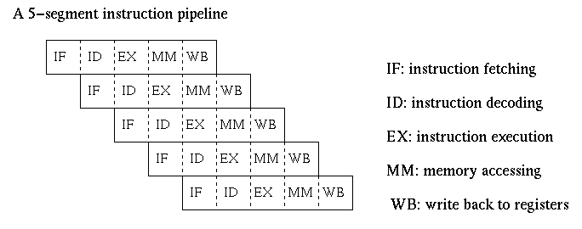
Instruction timing (cont.)
Pipeline concept for example:
Pipeline Hazards:
Data hazards (RAW, WAR, WAW)
Structural hazards (Hardware)
Control hazards (Branch)
Notes:
Remember the exam Prof. Yang give them before, this is for example, not our PIC18F4520.
Structural hazards is: Lack of hardware resources is not enough and lead to the same time to execute a number of instructions can not be implemented.

Slide 51
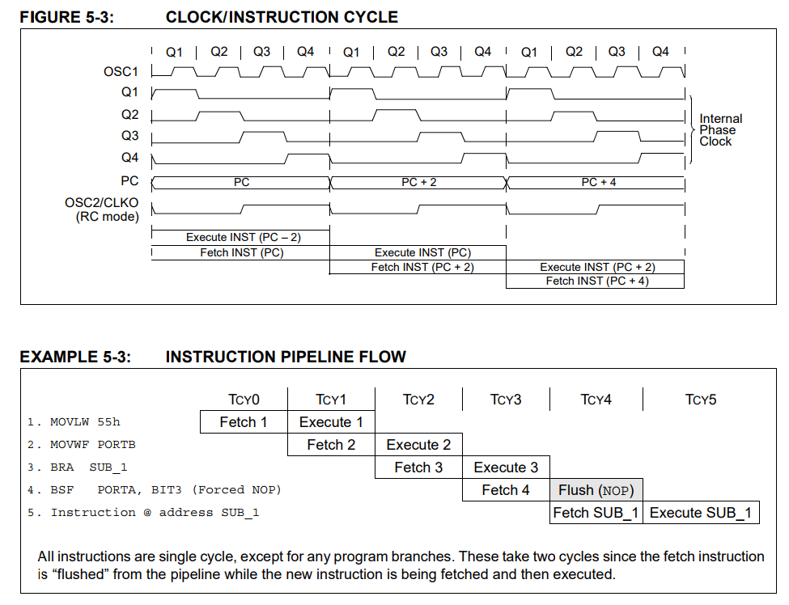
Instruction timing (cont.)

Slide 52
Instruction timing (cont.)
T_{CY} = 4 * T_{OSC}
each instruction effectively executes in one cycle(T_{CY}).
An instruction causes the program counter to change then two cycle(T_{CY}) are required to complete the instruction
Two-word instruction b

Slide 53
LAB - Bonus
Read four instructions of the four basic categories and explain to TA. (Instr. is selected by TA)
1. Open the PIC18FXXXX Data Sheet website and find out the instruction by your own hands.
2. Explain each step of spec. as clearly as possible.
3. You can do this Bonus ONLY after you finish two Labs above (Lab3-1 and Lab3-2).

Slide 54
LAB – Bonus (cont.)

Slide 55
LAB – Bonus (cont.)
Choice 1.
BYTE-ORIENTED OPERATIONS - ADDWF
Choice 2.
BIT-ORIENTED OPERATIONS - BCF
Choice 3.
CONTROL OPERATIONS – BC
Choice 4.
LITERAL OPERATIONS - MOVWF
Notes:
Not necessary which is more easy.

Slide 56
Thanks you for listening

